Slide 1

CNENGR506
6.1 Optimal & Predictive Control

Slide 2


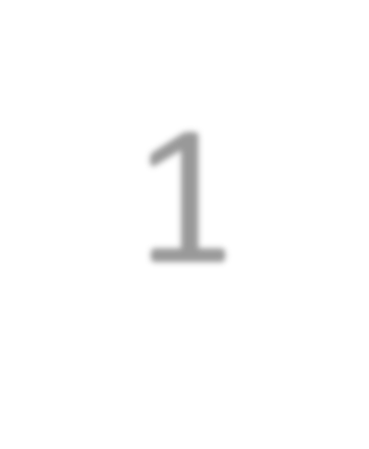



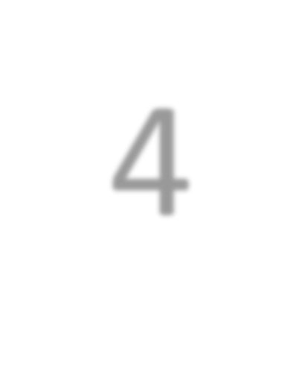
Syllabus
3
System
Identification
Concept of Feedback, Terminology and Objectives of Control
1
2
Optimal control
Introduction to “Modern Control”
Robust control
6
Transfer Functions represented using the
Theory
5
Backward Shift operator
State variable
Stochastic control
feedback using non-minimal state space models
pole assignment and 4
Block diagram analysis,
discrete-time PI control
Feed-forward control
CORE TOPIC
Multivariable & Non-linear

Slide 3
ENGR406 (506)
Intelligent System Control
Contents
Part 1 – Terminology and Objectives of Control
Part 2 – Discrete–Time Transfer Function Models
Part 3 – System Identification
Part 4 – Discrete–Time Control & Pole Assignment
Part 5 – State Variable Feedback
Part 6 – Additional Topics & Case Studies

Slide 4
Part 6 – Additional Topics & Case Studies
Contents
Section 6.1 – Optimal & Predictive Control
Section 6.2 – Multivariable Control
Section 6.3 – Implementation Forms
Section 6.4 – Adaptive & Nonlinear Control

Slide 5
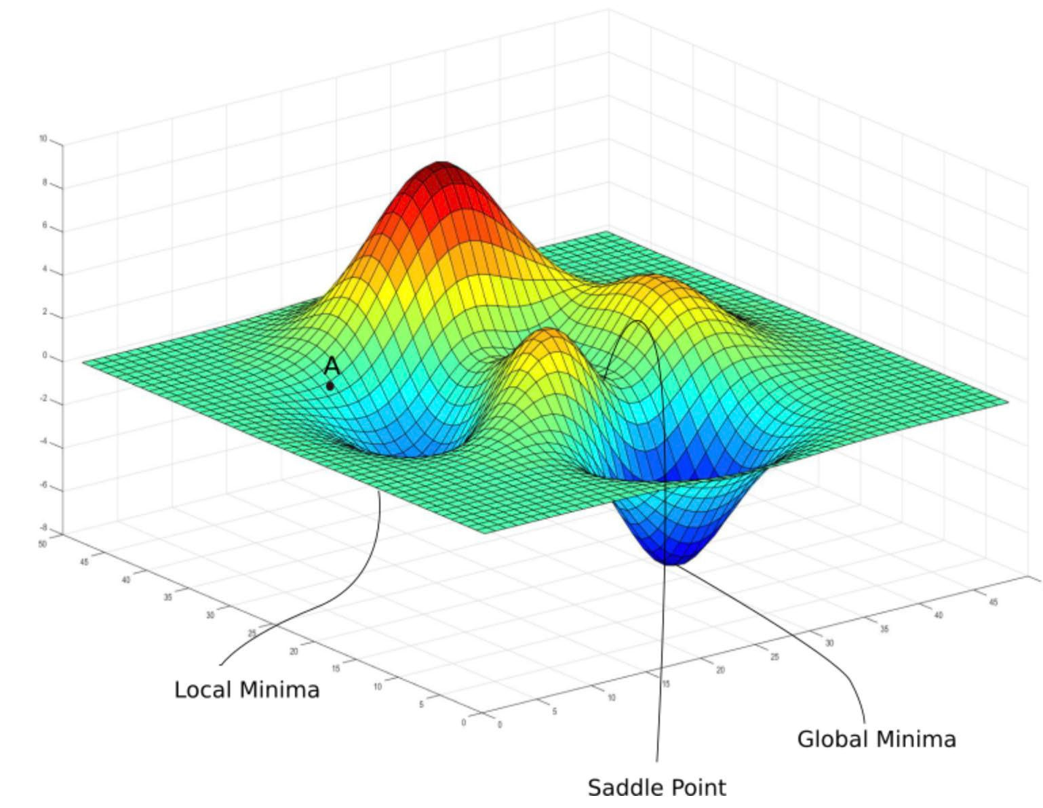
Optimal Control
Optimal controllers simultaneously ensure the completion of the system objectives and the minimization of a
J
performance index (cf. Part 3 of the module)
https://blog.goodaudience.com/ gradient-descent-for-linear- regression-explained- 7c60bc414bdd
5

Slide 6
Optimal controllers
Optimal controllers are designed to control dynamic systems in a way that minimizes (or maximizes) a specified performance criterion, often related to energy, error, or cost.
The goal is to find the best possible control inputs that will steer the system from its initial state to a desired final state, adhering to any given constraints.

Slide 7
Key highlights of optimal controllers

Slide 8
Cost Function Minimization:
Optimal control theory focuses on defining a cost function (or objective function), which quantifies the performance of the system. This could include terms related to control effort, state deviations, or time. The controller is designed to minimize this cost over the system's operation time.

Slide 9
Types of Optimal Controllers:
Linear Quadratic Regulator (LQR): Common for linear systems, LQR minimizes a quadratic cost function involving the states and control inputs. It’s widely used due to its simplicity and effectiveness in balancing performance with control effort.
Model Predictive Control (MPC): This advanced control method uses a model of the system to predict future states and optimize the control inputs over a finite time horizon. MPC is especially valuable in handling constraints on states and inputs.
Dynamic Programming: An approach that breaks down the optimization problem into smaller subproblems. Although challenging to apply in real-time for complex systems, it’s a powerful technique for systems with discrete states.

Slide 10
Performance Criteria:
Optimal controllers often balance between conflicting goals, such as minimizing control effort and ensuring fast system response. Performance criteria can be customized for energy efficiency, precision, robustness, or speed.

Slide 11
Applications:
Optimal control is essential in areas requiring precise control and efficiency, such as aerospace (flight control), automotive (engine and suspension systems), robotics, and industrial process control.

Slide 12
Stability and Robustness:
Optimal controllers are generally designed to ensure system stability, though robustness (handling of uncertainties and disturbances) depends on the chosen approach and specific design.

Slide 13
Trade-offs:
Optimal control often requires computational resources and system modeling. LQR, for instance, is more suitable for linear systems, while MPC can handle nonlinearities and constraints but is computationally intensive.

Slide 14
Linear Quadratic
∞
∑
( x(i) Qx(i) + r(u(i) ) )
J =
T 2
i=0
Linear Quadratic (LQ) performance criterion
Q is a symmetric weighting matrix and r is a positive scalar weight (or matrix in the multivariable case)
Weights can be chosen by the designer or numerically optimised to satisfy a wide range of performance criteria
Example: for an aircraft control system, we can decouple the flight parameters such as pitch and velocity

Slide 15
Example: Aircraft Control System
In aircraft control, LQ control can be used to manage parameters like pitch (angle of ascent/descent) and velocity (speed). By appropriately selecting Q and R, the LQ controller can decouple these parameters, meaning:
Pitch Control: The weight on pitch-related state variables in Q can be increased if we want precise control over the aircraft’s ascent or descent.
Velocity Control: Similarly, weights on velocity-related states can be adjusted in Q to ensure stable and efficient speed control.
This decoupling effect allows the controller to manage each aspect of flight independently, optimizing performance in each dimension (pitch and velocity) without interference from the other.
By appropriately balancing Q and R, the system achieves a well-tuned control response for stable and efficient aircraft flight.

Slide 16
PIP–LQ control
PIP–LQ control, or Proportional-Integral-Plus Linear Quadratic control, is an advanced control approach that combines Proportional-Integral-Plus (PIP) control with Linear Quadratic (LQ) optimization. This hybrid method is particularly useful for controlling dynamic systems with uncertainties or disturbances.

Slide 17
Key Components of PIP–LQ Control
Proportional-Integral-Plus (PIP) Control: PIP control is an extension of traditional PID control, but it includes terms that account for more complex system dynamics, including integral and derivative feedback. It’s commonly applied to systems with lagged responses or other complexities not easily managed by standard PID control alone.
Linear Quadratic (LQ) Optimization: LQ control uses a cost function that includes terms for state variables and control effort, typically in a quadratic form. The aim is to minimize this cost function, achieving an optimal balance between control performance and control effort. LQ control is typically applied to linear time-invariant systems, but can be adapted for use in PIP control as well.
Hybrid Control Strategy: In PIP–LQ control, the control design uses PIP structure for intuitive, robust control of complex dynamics, while LQ optimization helps ensure optimal performance. This combined approach enhances system stability, robustness to disturbances, and cost efficiency in control efforts.

Slide 18
Robust Control
Robust control is a controller design method that focuses on the reliability (robustness) of the control algorithm.
Robustness is usually defined as the minimum requirement a control system has to satisfy in order to be useful in a practical environment.
Robust Control is an approach in control theory that ensures a system remains stable and performs effectively even when there are uncertainties or variations in the system parameters.
This type of control is essential in real-world applications where systems are often subject to disturbances, modeling errors, and unpredictable changes in their operating conditions.

Slide 19
Robust Control
Design method that focuses on the reliability (robustness) of the controller
Robustness is defined as the minimum requirement a control system has to satisfy to be useful in a practical situation
Typically based on the worst-case scenario but may not be optimal under normal circumstances

Slide 20
Predictive Control
Many industrial control applications
Model is used to predict the future output
Controller designed to generate optimal input signals into the future
Such optimisation is repeated at each sampling instant (receding horizon)

Slide 21
Part 6 – Additional Topics & Case Studies
Contents
Section 6.1 – Optimal & Predictive Control
Section 6.2 – Multivariable Control
Section 6.3 – Implementation Forms
Section 6.4 – Adaptive & Nonlinear Control

Slide 22
Coupled System in Open Loop (No Controller)
U1
dynamics
Y1
U2
dynamics
Y2

Slide 23
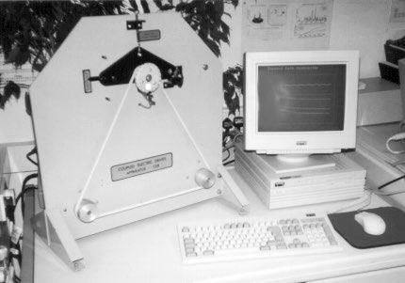
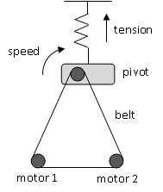
Laboratory Coupled Drives System

Slide 24
Open Loop Response
0.6
0.4
0.2
0
0.6
0.4
0.2
0
u to y
1 1
u to y
1 2
-0.2
0
20
40
-0.2
0
20
40
0.6
0.4
0.2
0
0
-0.2
-0.4
-0.6
u to y
2 1
u to y
2 2
-0.2
0
20
sample no.
40
0
20
sample no.
40

Slide 25
Multiple-Loop Control
D1
U1
U1
controller
dynamics
Y1
D2
controller
dynamics
Y2
U2
U2

Slide 26
Multivariable Control
D1
U1
dynamics
Y1
controller
D2
dynamics
Y2
U2
u(k ) = −K . x(k )

Slide 27
Coupled Drive Transfer Function Models
⎡
0.0602z⁻¹
0.0666z⁻¹
⎤
⎡ y₁(k ) ⎤
⎢
1− 0.8696z⁻¹
1− 0.8696z⁻¹
0.1385z⁻¹ − 0.2610z⁻²
⎥ ⎡u₁(k ) ⎤
_{⎥ =} ⎢
⎥ ⎢
⎢
⎢ −0.1150z⁻¹ + 0.2603z⁻²
⎥
⎣ y₂ (k )⎦
⎥ ⎣u₂ (k )⎦
⎢
⎥
⎣1−1.3077z⁻¹ + 0.7374z⁻²
1−1.3077z⁻¹ + 0.7374z⁻² ⎦

Slide 28
Coupled Drive Matrix Fraction Description
^{⎡ y1 (k ) ⎤} = A(z⁻¹ )⁻¹ B(z⁻¹ ) ^{⎡u1 (k ) ⎤}
⎢ ⎥ ⎢
⎥
⎣ y₂ (k )⎦
⎣u₂ (k )⎦
A(z⁻¹) = ^{⎡1}
0⎤ ⎡−0.8696
+
0
⎤ −1
z
₊ ⎡0 0
⎤ −2
z
⎢₀ ₁⎥ ⎢
0
−1.3077⎥
⎢₀
0.7374⎥
⎣
⎦ ⎣
⎦
⎣
⎦
_{B(z1) =} ⎡ 0.0602
0.0666⎤ ₋₁ ⎡ 0
z +
0
⎤ −2
z
⎢−0.1150
0.1385⎥ ⎢0.2603
−0.261⎥
⎣
⎦
⎣
⎦

Slide 29
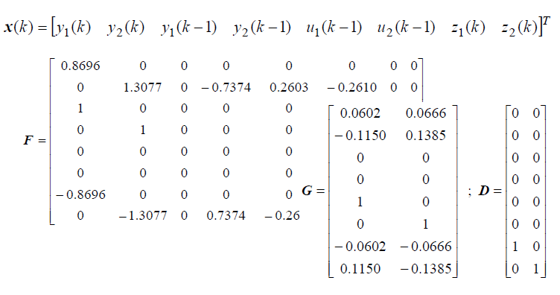
Coupled Drive Non Minimal State Space Model

Slide 30
Coupled Drive LQ Optimal Control Design
Q = diag[0.25
R = diag[1.0
0.25
1.0]
0.25
0.25
0.5 0.5 0.01 0.01]
⎡0.3452
0.0636
− 0.0249
0 − 0.1936
0 0.1545
0.0683
− 0.0545
− 0.0685
0.0547
− 0.0519
− 0.0600
− 0.0579⎤ 0.0497 ⎦
K = ⎢
⎥
⎣0.3990
u(k ) = −K ⋅ x(k )

Slide 31
Closed Loop Results (Outputs)
1
1
output 1
0.5
0.5
output 2
0
0
0
100
200
0 100 200
1
1
output 2
0.5
0.5
output 1
0
0
0
100
200
0 100 200
sample no.
sample no.

Slide 32
Closed Loop Results (Control Inputs)
0.05
input 1
0.2
input 2
0
0.1
-0.05
0
10 20 30
10 20 30
0.05
input 1
0.2
input 2
0
0.1
-0.05
0
10 20 30
10 20 30
sample no.
sample no.

Slide 33
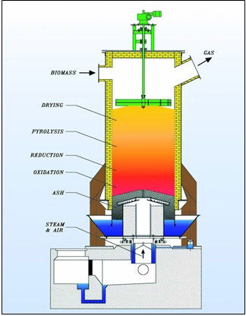
Biomass Gasifier
Multivariable control of pressure, temperature and various flow rates to optimise fuel gas output

Slide 34
Biomass Gasifier (2)
The gasification process converts (e.g.) raw biomass into a combustible gas, with energy content with the region of 60-70% of the original biomass stock
This gas can then be burnt to produce thermal energy, or to run engines for mechanical or electrical power
The gasifier system requires control of temperature, pressure, flow rates, etc.
Biomass is harder to optimise than coal as it has an uneven fuel input (e.g. wood)

Slide 35

Part 6 – Additional Topics & Case Studies
Contents
Section 6.1 – Optimal & Predictive Control
Section 6.2 – Multivariable Control
Section 6.3 – Implementation Forms
Section 6.4 – Adaptive & Nonlinear Control

Slide 36
Example 7 from Part 5:
Forward Path Block Diagram Form
u(k )
+
k
+
1
y(k )
I
−1
−2
−3
b₁z + b₂ z + b₃ z
1− z⁻¹
−1
−2
y_{d} (k )
1+ g₁z + g₂ z
−1 −2
−3
1+ a₁z + a₂ z + a₃ z
−
−
plant
integral
forward path filter
 | b^{ˆ} z⁻¹ + b^{ˆ} z⁻² + b^{ˆ} z⁻³ 1 2 3
 | 1+ aˆ₁z⁻¹ + aˆ₂ z⁻² + aˆ₃ z⁻³
−1
−2
f₀ + f₁ z + f₂ z
feedback filter
model

Slide 37
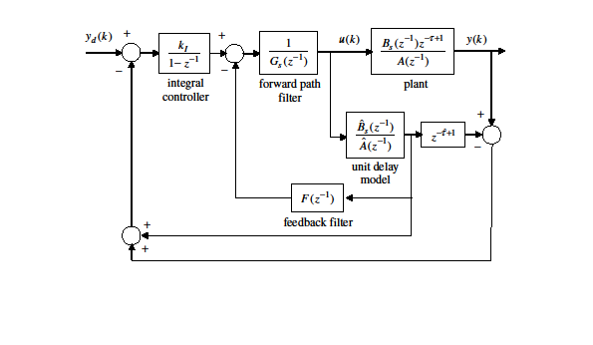
Smith Predictor for Long Time Delays
Unit delay model

Slide 38
Part 6 – Additional Topics & Case Studies
Contents
Section 6.1 – Optimal & Predictive Control
Section 6.2 – Multivariable Control
Section 6.3 – Implementation Forms
Section 6.4 – Adaptive & Nonlinear Control

Slide 39
Nonlinear Control
The linear control methods considered in this module, based on linear models, are applicable to real world nonlinear problems
Nonlinear control system design yields more complex control systems but can yield improved performance for some applications – and is sometimes essential
Many methods for nonlinear control system design (adaptive, linear parameter varying, sliding model control, and so on) but no general theory!

Slide 40
Examples of Nonlinear Control
Adaptive control – see next few slides
Research seminar on improved control of the vibro- lance ground compaction system
Research seminar on state dependent parameter control of hydraulically actuated robotic manipulators

Slide 41
Fixed Gain Control
Collect data and find the transfer function control model off-line
Calculate the control parameters from the model
Calculate the control input signal
Repeat step 3 at each sampling interval
Advantage: simple to implement, while the closed loop system is linear and therefore straightforward to analyse
Disadvantage: if the system parameters are non-stationary (time varying) then the control is not satisfactory

Slide 42
Adaptive Control (1)
Collect data and find transfer function model structure off-line
Estimate the parameters on-line using the input and the output
Calculate the control parameters from the model
Calculate the control input signal
Repeat steps 2-4 for each sample

Slide 43
Adaptive Control (2)
Control Design Calculation
Parameter Estimator
u_{k}
D_{k}
x
k
Controller
S ystem
Disadvantage: more complex and possibly more costly. Also, nonlinear so more chance of something going wrong
Self-tuning controllers: find appropriate gains when the system is first turned on, but then may assume the system is time invariant

Slide 44
Conclusions
This section has completed the course syllabus
Next…
How do Engineers balance performance and robustness in control system design?

Slide 45
Syllabus
3
System
Identification
Concept of Feedback, Terminology and Objectives of Control
1
2
Optimal control
Introduction to “Modern Control”
Robust control
6
Transfer Functions represented using the
Theory
5
Backward Shift operator
State variable
Stochastic control
feedback using non-minimal state space models
pole assignment and 4
Block diagram analysis,
discrete-time PI control
Feed-forward control
CORE TOPIC
Multivariable & Non-linear
10

